Slide 2
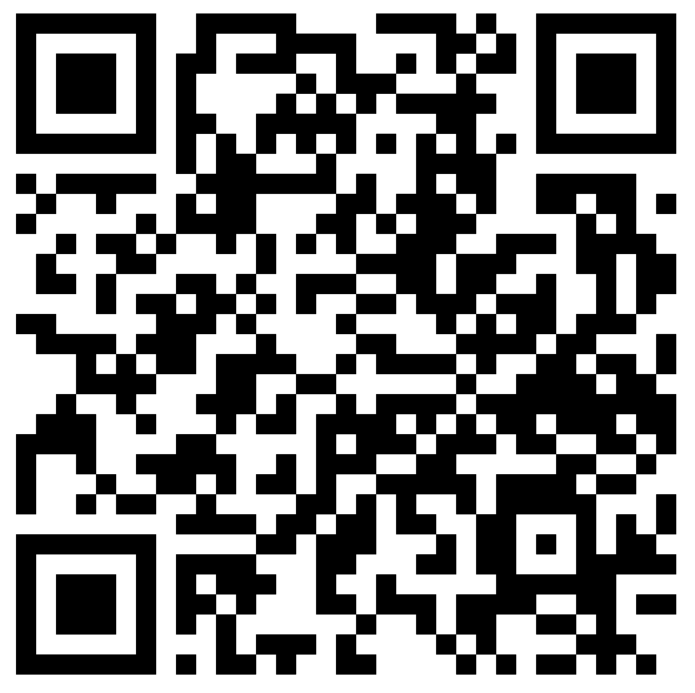
Join us for our AGM, Shine 2025
Where? Church Of Ireland Theological Institute (CITI), Dublin
When? Saturday 29th March, 10:30am – 3:30pm
How much? It’s free, lunch is provided and we’ll even help with transportation if necessary!
What’s next? Sign up to secure your place and catering for the event. Visit our website or register now with
using this QR code.

Slide 3
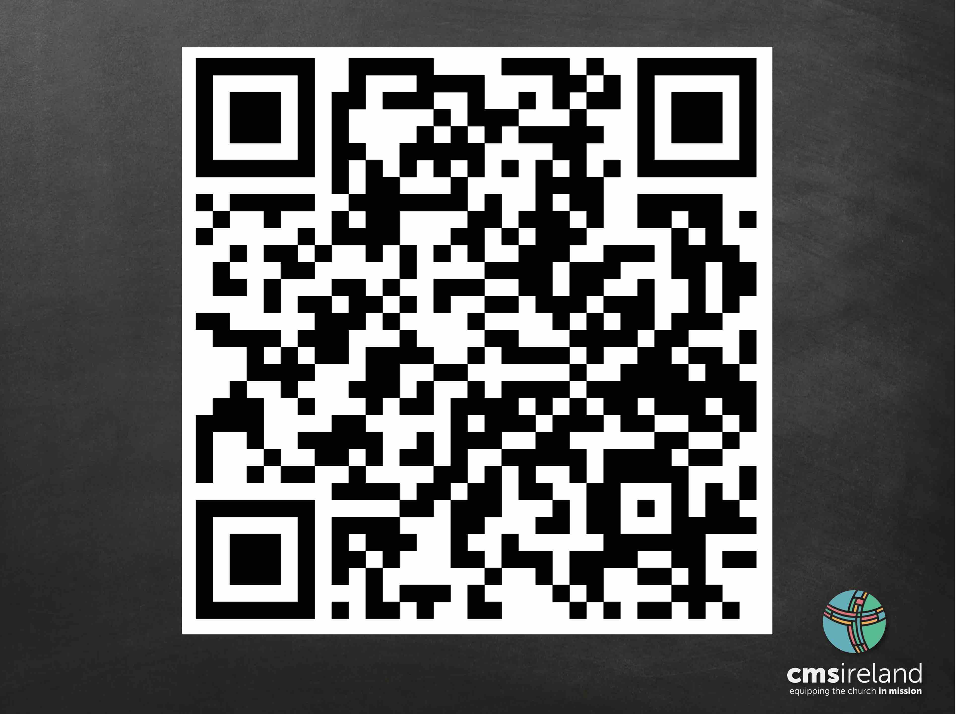

Slide 5
Join us for our AGM, Shine 2025
Where? Church Of Ireland Theological Institute (CITI), Dublin
When? Saturday 29th March, 10:30am – 3:30pm
How much? It’s free, lunch is provided and we’ll even help with transportation if necessary!
What’s next? Sign up to secure your
place and catering for the event. Visit
our website or register now with
this QR code.

Slide 6
