Slide 1


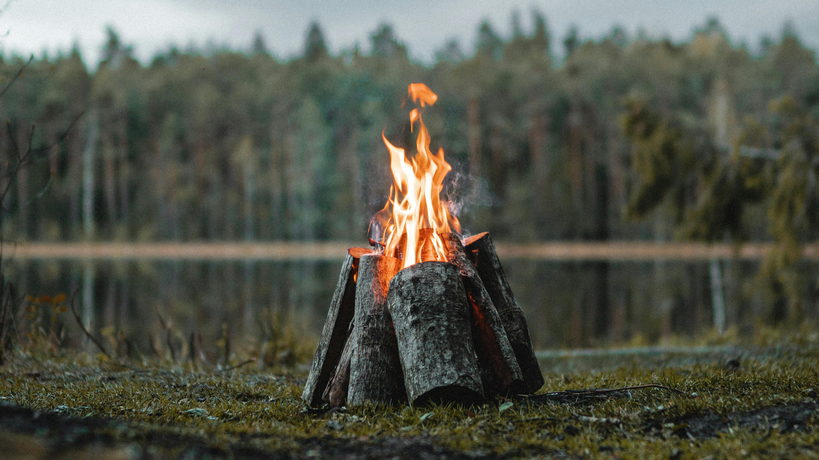
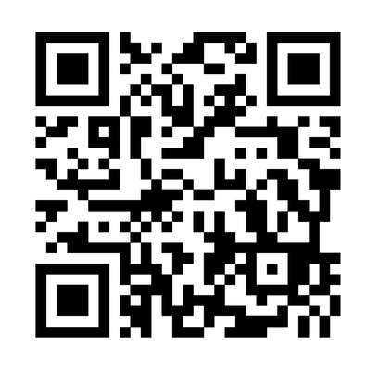
2026
Saturday 12th September
10.30am - 5pm
Registration from 9.45am
Dromantine Retreat and Conference Centre
Friday Extra 11th September from 7.30pm
Register via our websibe www.cmsireland.org or by using the QR code

