Slide 1
Lesson 2

Slide 2
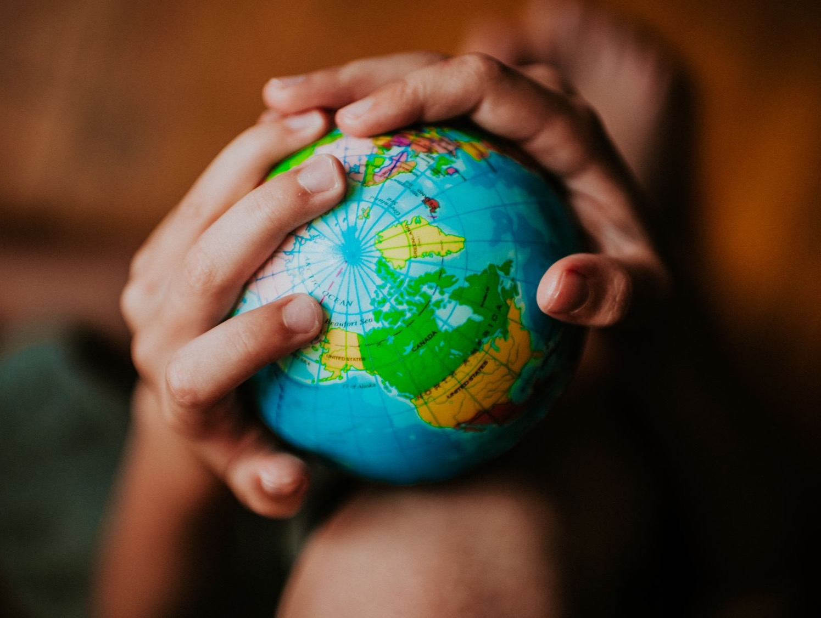
Recap
What country were we in?
Why should we care about the earth?

Slide 3
mirror vs paper

Slide 4
Genesis 1:27

Slide 5
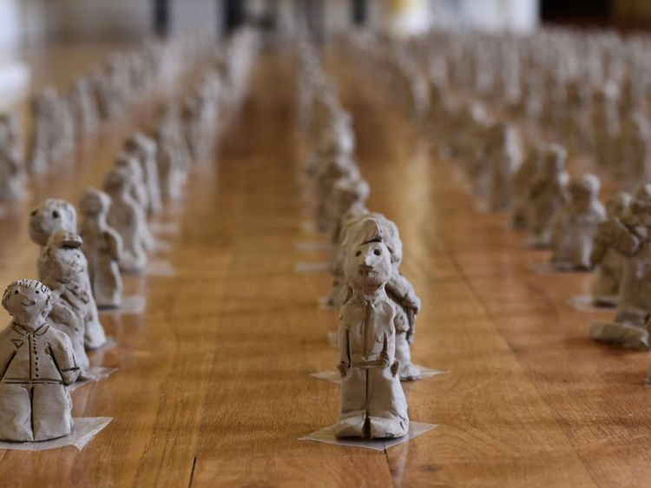
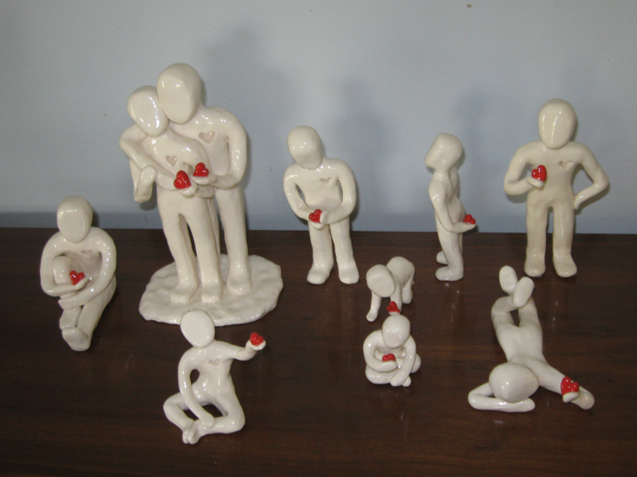
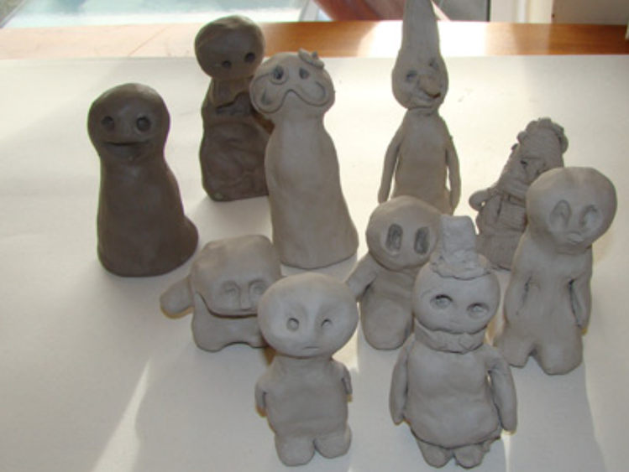
Made in the image of God
images: shevet, trinity nottingham, South Lanarkshire primaries, pinimg

Slide 6
Key Question
What happens when we don’t care?

Slide 8
Serve and be served

Slide 9
Foil Boats

Slide 10
Prayer
Dear God, help us to care for others by sharing our love and our lives with them. May our service make you smile! Amen

