Slide 1
Lesson 3

Slide 2
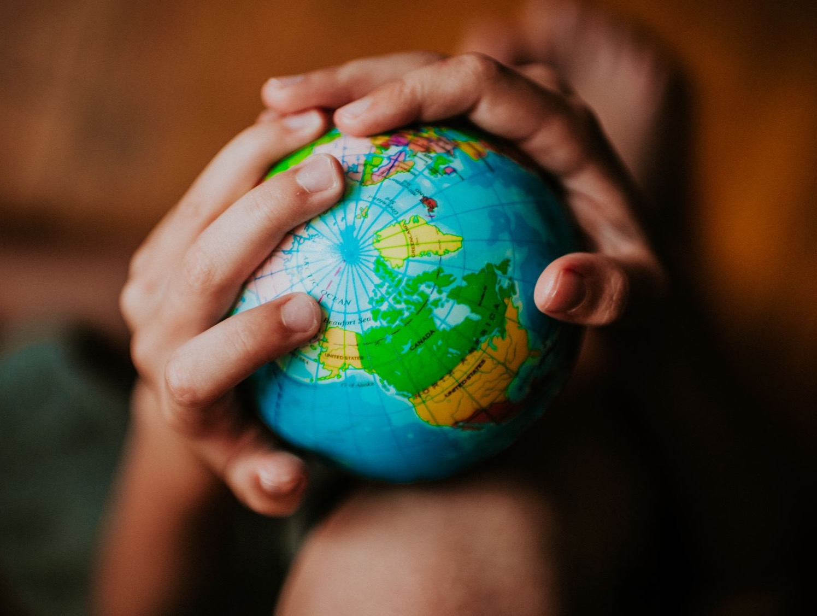
Recap
Why should we care about the earth?
What happens when we don’t care?

Slide 3
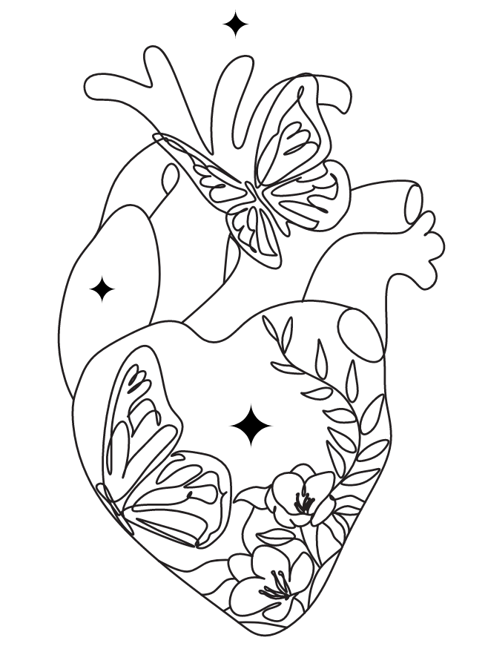
Mark
“The most important one,” answered Jesus, “is this: ‘Hear, O Israel: The Lord our God, the Lord is one. Love the Lord your God with all your heart and with all your soul and with all your mind and with all your strength.’
The second is this: ‘Love your neighbour as yourself.’ There is no commandment greater than these.”
12:29-31

Slide 4
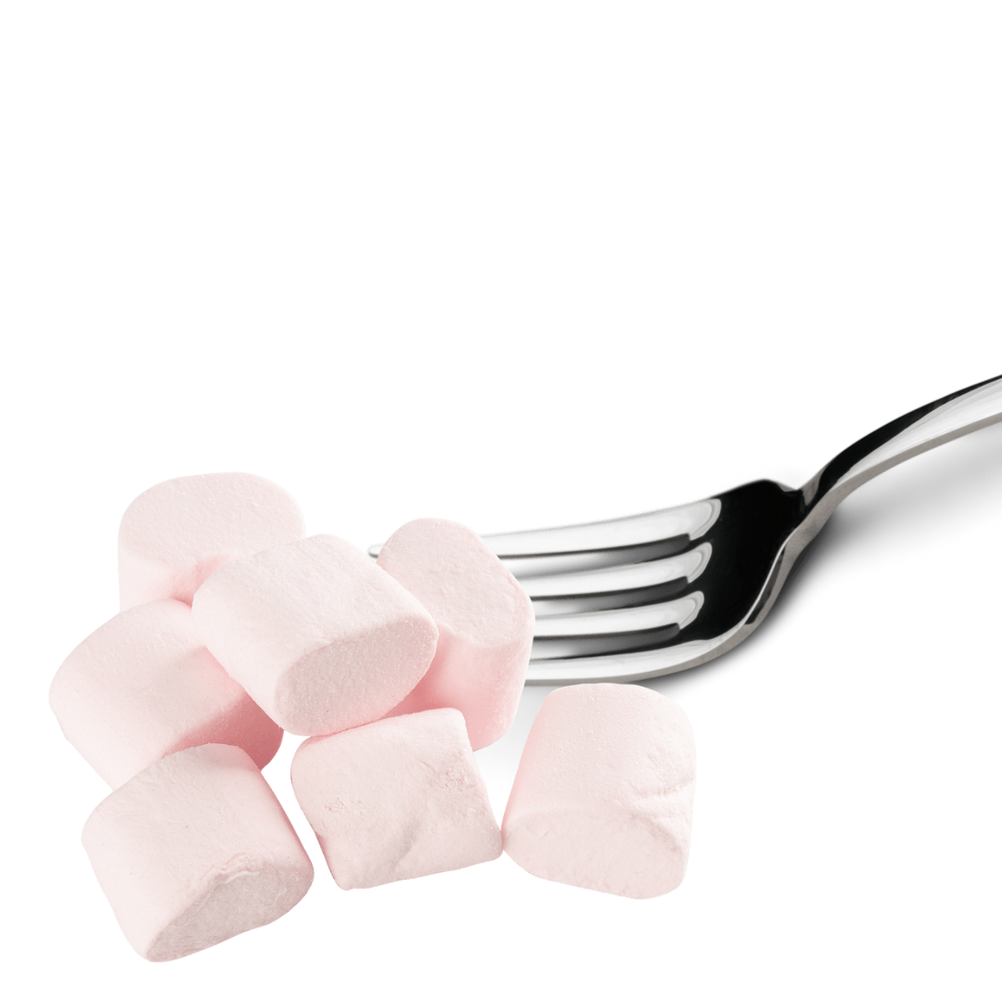
Stick it to your neighbour

Slide 5
Key Question
Why should we care about people far away?

Slide 8
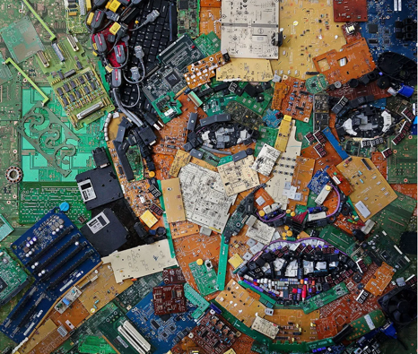
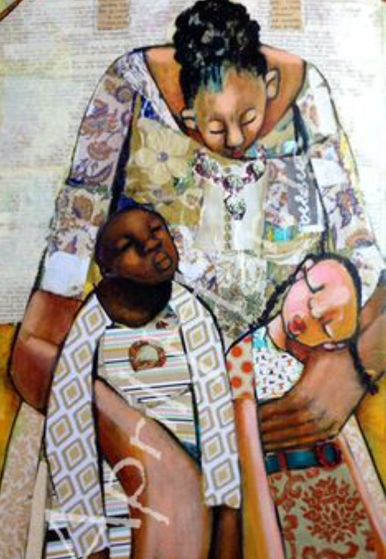
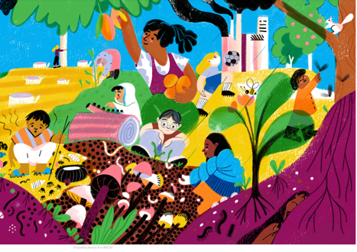
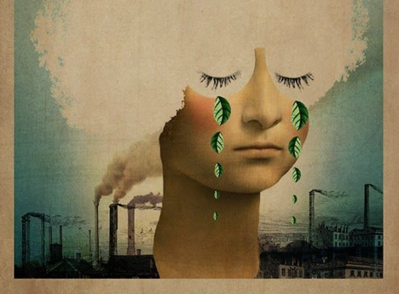
Loving others
collage craft
images: Firadaus, Alonso, Melnyk, Harrison, Galima

Slide 9
Reflect
How can you switch off unhelpful self-love and turn instead to a holy, life-giving love that leads us to live for others the way that God would have us live?
What are the implications of Christ’s imperative to bear one another’s burdens for your life?

Slide 10
Prayer
Dear God, thank you that you love every single person alive today. Help us to love others better – as you would want us to. Amen

