Slide 1
Lesson 3

Slide 2
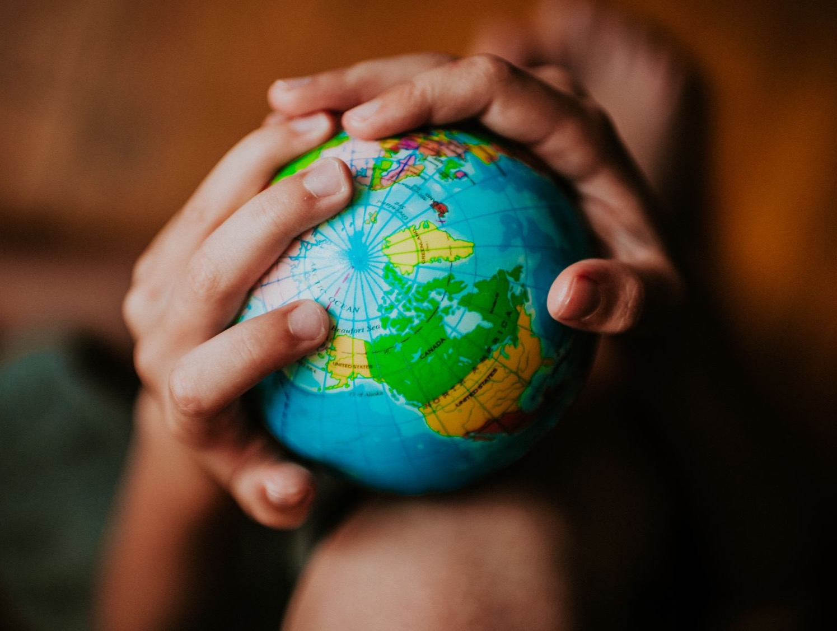
Recap
Why should we care about the earth?
What happens when we don’t care?

Slide 3
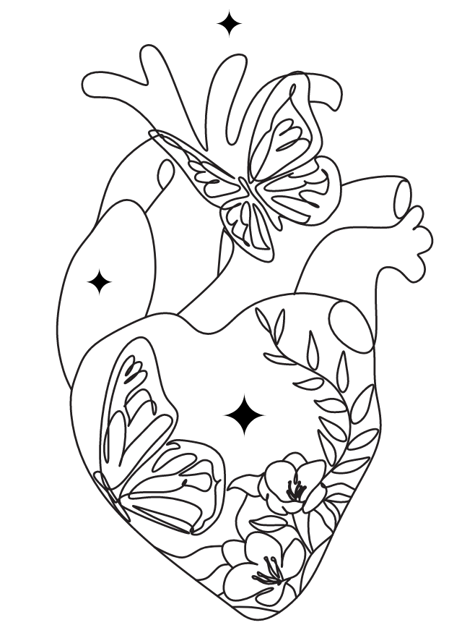
Mark
“The most important one,” answered Jesus, “is this: ‘Hear, O Israel: The Lord our God, the Lord is one. Love the Lord your God with all your heart and with all your soul and with all your mind and with all your strength.’
The second is this: ‘Love your neighbour as yourself.’ There is no commandment greater than these.”
12:29-31

Slide 4
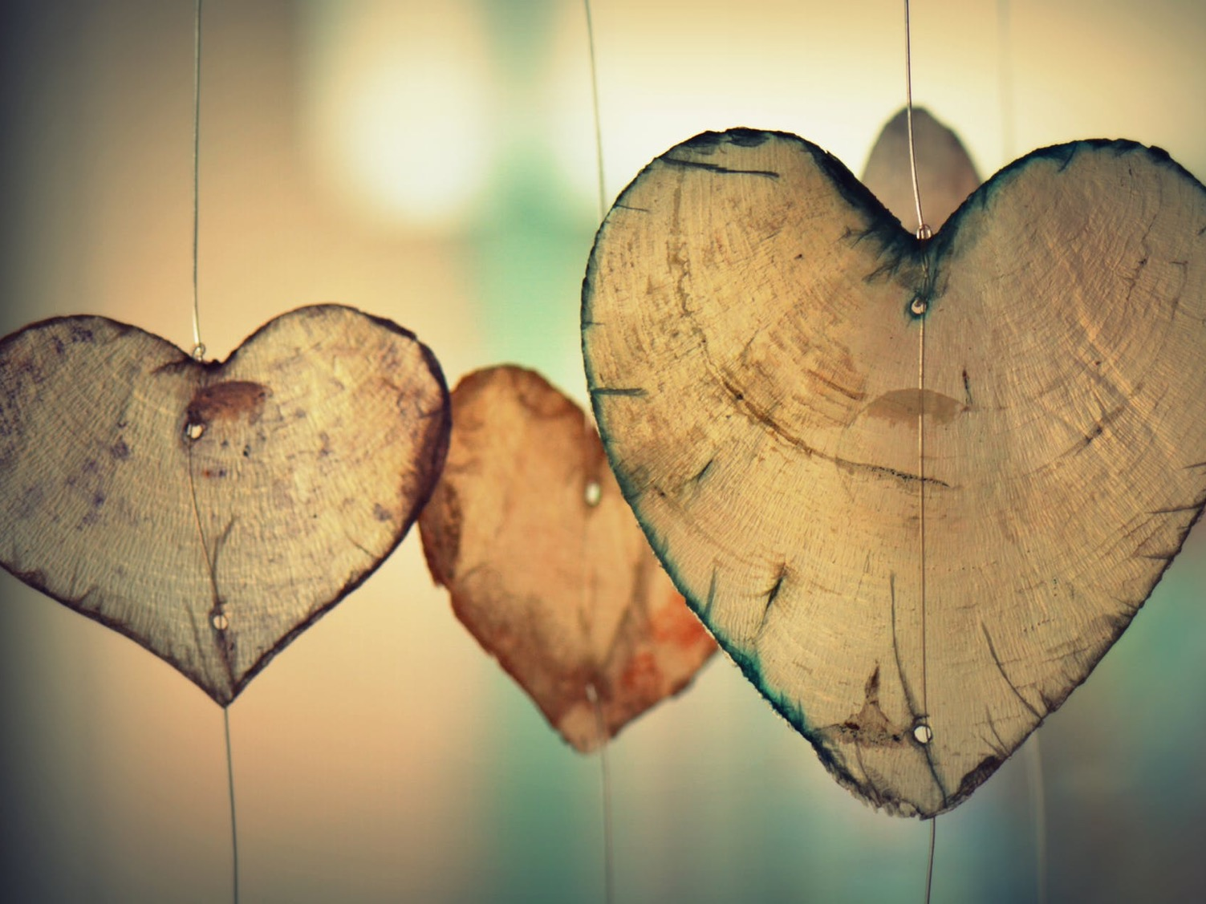
Love charades

Slide 5
Key Question
Why should we care about people far away?

Slide 7
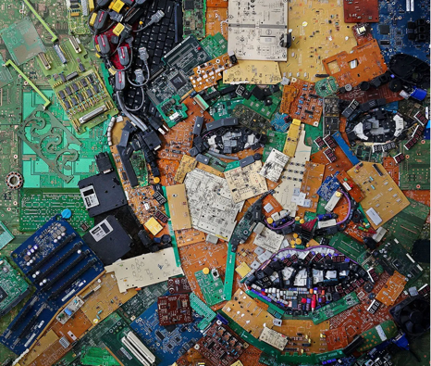
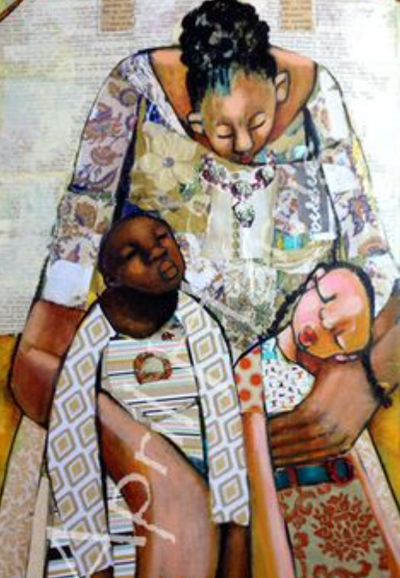
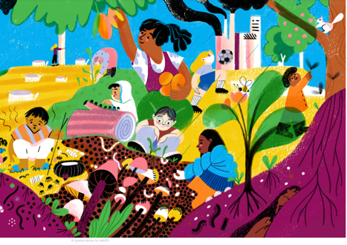
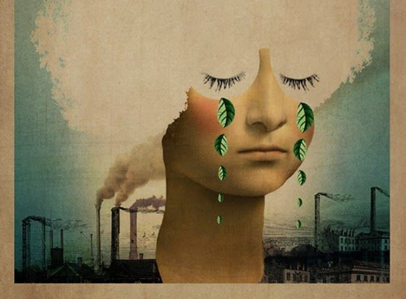
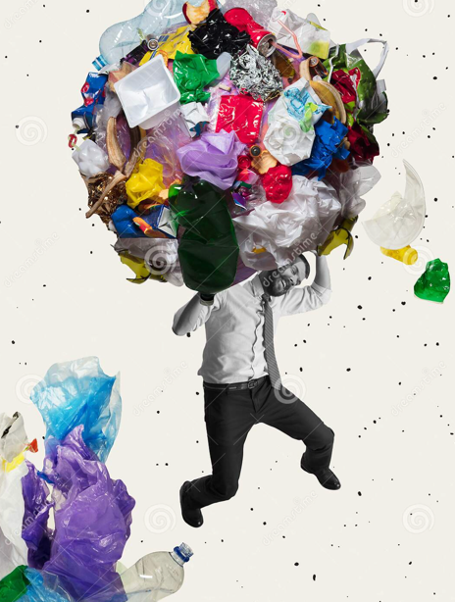
Loving others
collage craft
images: Firadaus, Alonso, Melnyk, Harrison, Galima

Slide 8
Prayer
Dear God, thank you that you love every single person alive today. Help us to love others better – as you would want us to. Amen

